Slide 1
The Multi-Schools Council Resilience Programme

Slide 2
Session 6
Resilience – what is it?
Resilience activity
Resilience targets
Scoring ourselves
Questions
Notes:
We’ve worked hard over the last five sessions to understand what resilience is, how it can help us manage the challenges in our lives, and how we can build it up. We’ve also learned regulation strategies to help us when the challenges just seem too big to manage. Finally, we’ve learned how important it is to look after ourselves mentally as well as physically.
So today we’re going to bring together everything we have learned in order to help us to reach our targets and goals. We’ll also re-score ourselves to see how much our resilience has increased from when we did the baseline score back in session 1.

Slide 3
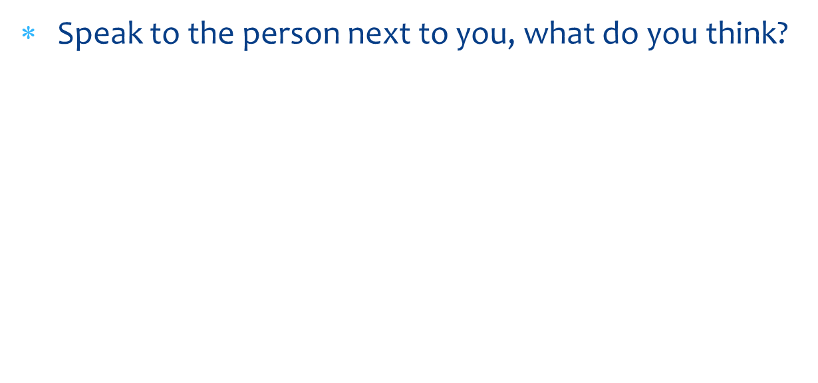
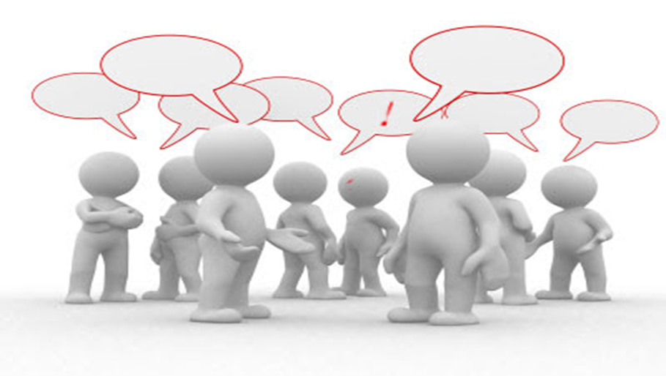
What is resilience?
Notes:
In session one we created this definition of resilience (show group definition from week one). Are we still happy with this? Do we want to change it? Add to it? Provide more detail? Work with a partner to see what changes you can suggest.
Use CYP feedback to create a better version of the original definition with more detail. Acknowledge how much progress the group has made with their understanding.

Slide 4
Watch this…
https://www.youtube.com/watch?v=HYsRGe0tfZc
Notes:
Here’s a short clip which really sums up what we have been working on in this project.
After watching the video, take any feedback or questions from CYP as required).

Slide 5
Activity 1
In a small group, can you put together a small piece of Drama that show’s someone being resilient to a problem
It may be a real problem or one you have made up
Think about what we have covered over the last 6 weeks
Notes:
One thing the video showed us was that it’s important to practice resilience skills on the small stuff so we are better equipped to deal with the big stuff.
We’re going to have a practice now with a small piece of drama (any pupils who can’t take part can write a script instead).
For this drama activity, you need to be in small groups of up to 4 people. Decide on a challenge or difficulty that young people might face (you can look at your ‘worries’ list for ideas) and show as a group how that person can become more resilient to those challenges.

Slide 6
Show our performances
Notes:
Watch each performance in turn (and reading of scripts if required).
Ask the audience to comment on what the issue or challenge is, and then say how resilient the person was to it, or how they coped with it and can therefore improve their resilience in the future.

Slide 7
Activity 2
On your piece of paper think about your top 5 targets for the year
They should be personal to you
How could you be more resilient so that you can reach these targets?
Notes:
Now we’re going to look at your personal targets. So have a think and write down your top FIVE targets for this year. They should be personal to you, and they don’t have to be school-related. They can be things that you want to improve in yourself. They can be short or long term targets.
Give pupils paper and 5 mins to do this task.
Now, have a look at those targets. Share them with your partner. Look at what each other has written. How can you be more resilient when working towards these targets? Do you need to give yourself a longer timescale? Do you need to involve someone else in it/ask for help? Do you need to be adaptable to changes in the target and expectations? Do you need allow yourself some more good time from your wellbeing plate?
Ask CYP to share one of their targets and how they can be more resilient in terms of meeting the target.

Slide 8
Score yourself
Use the model to score yourself
2 is the lowest score and 10 the highest
How resilient do you feel right now to challenges you might face in these groups?
Maybe you have already experienced challenges
Maybe some of the work over the past 6-weeks has made you more resilient
Notes:
Now let’s go back to when we scored our resilience back in Session 1. Re-score yourself now based on what you’ve learned.
How resilient do you feel right now to challenges that you might face? Maybe some of the work we’ve done over the last five weeks has increased your resilience.
Allow time for this activity.
Now I’d like you to speak with a partner and show them where you have really improved your resilience in comparison to before this project. Are there any areas where you are ‘stuck’? If so, what can you do about it? Think about the wellbeing plate, Maslow’s pyramid (and the ladder) and your good mood list!
Allow time for this and ask CYP to report back on their progress.

Slide 9
A few reminders….
Notes:
Share visuals to link back to the activities of the programme. Take feedback from the group regarding the following:
What did you enjoy?
What did you find really helpful?
Will you use any of the tools or strategies you’ve learned during this project? If so, which ones?
What would you like to know more about?
What would you like to do again?

Slide 10
Any final questions for me?
Notes:
Are there any questions that have arisen today as a result of this session? Anything you’d like to know more about or discuss in more detail?

