Slide 1
The Multi-Schools Council Resilience Programme

Slide 2
Session 4
Mood work
Maslow activity – what affects my mood
What is mental health?
Mental health activity
Questions
Notes:
So far in these sessions we have introduced the concept of resilience, looked at definitions (ensure the group definition is displayed somewhere in the room), looked at our own worries both inside and outside of school and looked at how we can group them into ones we can and can’t control.
In the last session we looked at regulation strategies and created our own wellbeing plates to refer to when we’re feeling overwhelmed or stressed.
In today’s session we’re going to move that forward and look at the impact of mood can affect us, and the importance of looking after our own mental health.
We’ll also look at practical ways of turning a bad ‘mood’ into a good ‘mood’. As always, there will be a chance to ask questions at the end of the session.

Slide 3
Activity 1
Write a top 5 list of things that put you in a good mood
Write a top 5 list of things that put you in a bad mood
Notes:
What do we mean by mood? What is a good or a bad mood?
Take answers from the class. Then hand round plain paper – one per student.
I want you to take this piece of paper and draw a line down the middle of it. On one half, list all of the things that put you into a BAD mood. On the other half list all the things that put you in a GOOD mood.
Give 5 mins for this task.
Take feedback from the class looking at the good mood.
What puts you in a good mood?
How/why?
Are these things that we have put onto our wellbeing plate? If not, can they be added now?
Now take feedback from the class looking at the bad mood.
What type of things put you in a bad mood?
Is it possible to change a bad mood into a good mood?
How? (Refer back to good mood, wellbeing plate etc)
How does this increase/improve our resilience?
It’s really important to understand that not everything can be positive all the time. That’s why we’ve undertaken this project in order to give us the strategies to build our resilience so we can better deal with challenges that come our way.

Slide 4
Now try this…
With your bad list think about how you could deal with that situation?
Maybe you could turn it a ‘good’ situation by making a small change?
Notes:
Now, on your own, go back to your BAD list and think about how you could deal with that situation. Is it possible to turn it into a GOOD situation? What could improve your mood? What might give you a break from BAD and increase the GOOD?
3 mins reflection or making notes next to their BAD list.

Slide 5
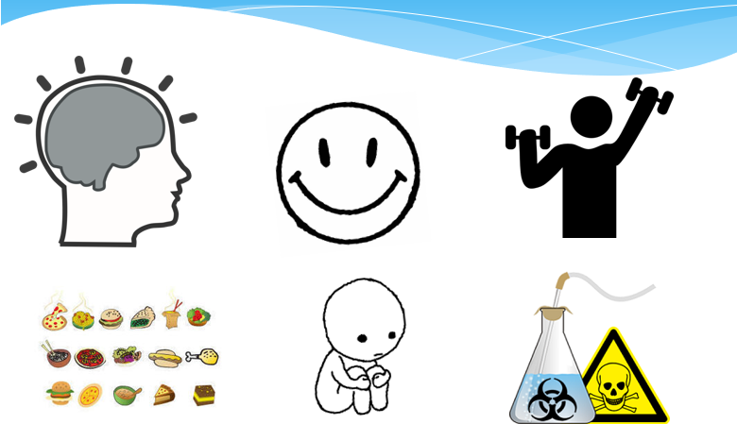
What could these images mean?
Notes:
Now, with your partner, look at images on the screen and discuss how they could link to resilience.
Give 5 mins and take feedback from the group. Ensure that the discussion draws out the following aspects:
impact of drugs and alcohol on mood
impact of loneliness and having the right people around us
importance of exercise and being active mind and body
balanced diet and the impact that can have
the smiley face is all about whether it’s realistic to be happy ALL the time. Sometimes you WILL be down and sad – and it’s important to learn to deal with it and find positive outlets (resilience)
brain picture is about how we look after it. We need to look after our mental health (sleep, being able to switch off, relaxation etc).

Slide 6
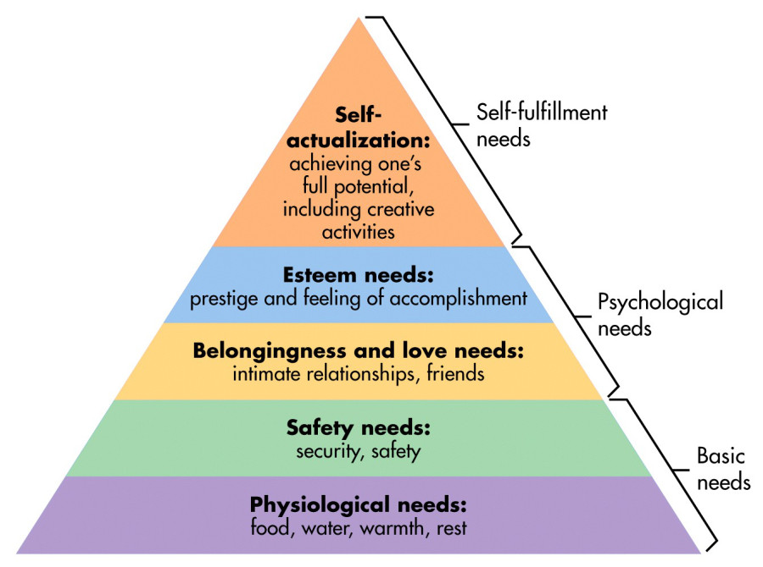
Maslow’s Hierarchy of Need
Notes:
Maslow’s hierarchy of needs is introduced. Vocab will need to be adapted depending on group and age.
This is Maslow’s hierarchy of needs. It’s a pyramid. All pyramids need strong base foundations in order for them to stand strong, just like people.
The aim for all of us is to be at the top of the pyramid, but this can only be achieved if the foundations are in place, so in order to understand it, and ourselves, we need to start at the foundations.
Firstly, as you can see, it is our physiological needs that have to be met – the things that keep us alive. Above that is the need to feel safe and secure. These are the absolute basics, and without them we can’t progress to the next level.
If those layers are in place and secure, we can then look at our psychological needs. If we have the layer of belonging, connection, friendships etc we can then move up up to the next session and see how that gives us our self-esteem and sense of self-worth. These are essential to us reaching the top of the pyramid.
And that is called ‘self-actualisation’ which is where we are achieving our goals, we’re creative, we are fulfilling our potential. But in order to be this, all the other layers need to be in place first.

Slide 7
Activity 2
On the sugar paper can you design your own ‘pyramid’ ?
What do you need to be the best you can be?
Discuss as a group and add in the ideas
Notes:
Now you’re going to use a plain piece of paper and you’ll create your own pyramid based on Maslow’s. It will be different to everyone else’s as you’re going to populate it with YOUR OWN needs in each of the layers.
Provide pupils with paper and pens to complete this task.
Now, I want you to draw a ladder next to your pyramid. Allow time for this.
We now understand what our own needs are, and we might be able to meet these. But sometimes things happen that our out of our control. For example, we might be in a really good mood, but if someone comes along and is mean to us, it might knock our self-esteem. We’d then use the ladder to climb down one level to find something/someone to meet that need.
So in that scenario we’d need to look at belonging, connection, friendships etc…. so we’d seek out a friend or family member to restore us back up the next level so we can climb the ladder back up again.
If that isn’t available, we might need to climb down to the next level to meet our needs. The important thing to remember is that the ladder goes both ways – we may climb down sometimes when challenges come our way, but we can use the tools on that lower level to help us climb back up again. This is resilience! The ability to bounce-back and overcome.

Slide 8
What is mental health?
Notes:
We hear a lot about mental health. So – what IS mental health?
Take ideas from the CYP.
How does mental health link to resilience?
Take ideas from the CYP.
Is there a stigma around mental health?
Take ideas from the pupils and challenge bias/stigma if and when it arises. Liken it to physical health and the lack of stigma in comparison. Also mention the rise of poor mental health during the pandemic and the drive to make it something that people talk about more openly.

Slide 9
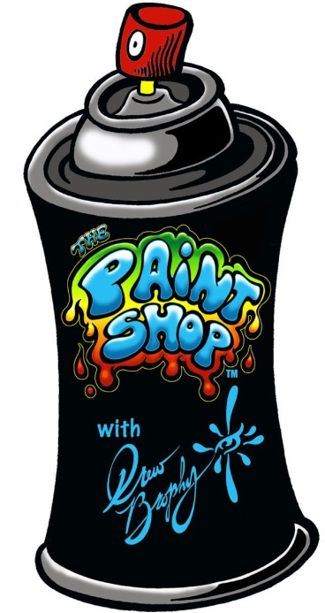
Activity 3
Using the graffiti cans and the plain sheets add all the positive words in green to do with mental health
Using the red colour add all the negative words
Notes:
This activity works best using the graffiti cans and bed sheets (OUTSIDE!!), but an be replicated using paint and pieces of paper, or chalk on a playground if necessary. However it needs to be art based and preferably outside.
For this activity, we are going to use graffiti cans and old bedsheets (adapt for what you’re using) and use them to write positive and negative words/phrases to talk about mental health. All the positive things we’re going to put in green – for example ‘it’s ok not to be ok’. Then in red we’re going to put negative or unhelpful phrases – for example – ‘they’re mental’.
Walk round the art work and discuss the positive and negative words. Encourage pupils to reflect on this and use only the green words in future.

Slide 10
Any questions?

