Slide 1
The Multi-Schools Council Resilience Programme

Slide 2
Session 3
What do you do to keep fit and healthy?
Meditation exercise
Yoga exercise
What would you do?
Questions
Notes:
So far in these sessions we have introduced the concept of resilience, looked at definitions (ensure the group definition is displayed somewhere in the room), looked at our own worries both inside and outside of school and looked at how we can group them into ones we can and can’t control. At the end of last session we looked at the importance of talking, and more importantly, or listening.
In today’s session we’re going to move that forward and look at ways to increase our resilience in our daily lives and routines so that when worries and challenges come our way, we’re in a better place to respond to them.
Today we’ll look at regulation strategies (ways to calm us when we feel stressed or anxious) and have a go at some meditation and yoga. We’ll also share our own regulation strategies to see what works for us as individuals, and perhaps give some ideas to others in the group.

Slide 3
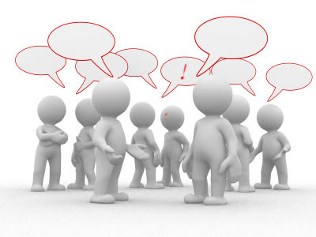
What do you do to keep mentally and physically fit and healthy?
Notes:
We’ll start by looking at what YOU do daily to keep yourself feeling mentally and physically well. In your pairs, write a list of all the strategies you use to regulate yourself when feeling overwhelmed or stressed. You have five minutes, then we’ll share the answers.
Discuss in pairs/small groups. Prompts may be needed so things like walking the dog, listening to music, meeting with friends, going for a run etc… If gaming comes up, then discuss the positives of this, but also the need to have limits.
Take feedback and list some on the board.

Slide 4
Meditation
Notes:
Many of you will have heard of meditation? How many of you have tried it?
For the next XX minutes I will read a meditation to you. You can relax, even put your head on your desks if you like (optional blindfolds). We’ll need silence in order to be successful. The room will be darkened and there will be no talking. This will take about ten minutes.
Adult then reads out meditation to students.
Afterwards take feedback:
How did it make you feel?
Would you do this again?
Do you do your own form of meditation in your life (although you might not have thought of it as meditation)?

Slide 5
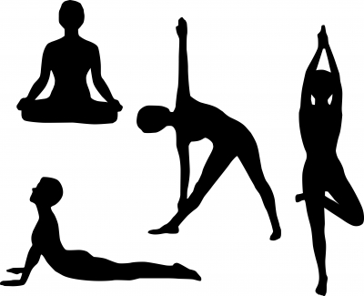
Yoga
Yoga for the Classroom 10 mins
15 Minute Chillout Yoga Session 15 mins
Notes:
Choose which of the videos to watch dependent on time available and space in your classroom.
Many people use yoga, and this video we’re about to watch will give us a ten/fifteen minute session of yoga.
Find yourself a space away from the tables etc (you may need to move furniture to the side of the room).
Afterwards take feedback:
How did it make you feel?
Would you do this again?
What link is there to how your body feels and how your mind feels?
There are apps that you can download onto your phone that have calming strategies to help you.

Slide 6
Making good choices
If you could create your own wellbeing plate what would go onto it?
What types of things would you not include on your plate?
Draw out a small plate and decide what goes on and what stay’s off?
Notes:
All of these regulation strategies we’ve talked about or tried today are all things can help us to lessen our worries and increase our resilience.
We’re now going to create our own ‘wellbeing plate’. This is going to be our way of regulating ourselves when things are feeling a bit tough. Like the focus on eating well, split the plate into many areas and in each section thin k about what you need to help reduce your worries and increase your resilience. On here you’re going to put YOUR strategies for YOU.
Then you can keep it on your bedroom wall or inside your folder to remind you of these strategies when you’re experiencing challenges.
They can reflect on their plate and see if they’re doing enough of the good stuff. They can keep this and take it away to continue to refer back to. You can also check that you’re doing enough of the good things, and if not, then you need to increase them.
Hand out paper plates or pieces of paper. CYP to write on their plate their regulation strategies. This can be made visual/colourful.
If anyone wants to share their wellbeing plate, this can be done within pairs or to the whole class.

Slide 7
Any questions?

