Slide 1
The Multi-Schools Council Resilience Programme

Slide 2
Session 2
Worries
School worries
Bucket activity
Who can you talk to?
Listening exercise
Questions
Notes:
Last week we introduced the concept of resilience, looked at definitions (ensure the group definition is displayed somewhere in the room) and started to look at the role of our worries and also our friendships in terms of resilience.
In today’s session we’re going to move that forward and try to find ways to increase our resilience by identifying our worries and finding solutions.
Last session we discussed some of the worries we have relating to school, home, ourselves and our lives. Today we’ll look specifically at worries relating to school and school life as these are often things we will all have in common or can relate to.
We’re then going to look at these worries and differentiate between those that we can control, and those that we can’t (bucket activity).
We’ll move on then to identifying people that we can talk to, or who can help us, and end up by learning the power of active listening.

Slide 3
Worries
What worries do you have in your life right now?
Use a post-it note and stick in on the worries board?
You don’t need to put your name
Notes:
Give each pair/table post-it notes.
On your post-it notes I want you to write down (one per post-it) any worries that you, or someone you know, has about your/their life right now NOT related to school. There are big ones (money/death/illness) and smaller ones. If you don’t feel comfortable sharing your own worries, then think about CYP in general and the worries they may be having right now about. Once you’ve done that, stick them to the wall/board.
Adults can role-model by sharing some of their own worries. Adult then reads out and collates into similar themes by moving the post-its.

Slide 4
School worries
What worries do you have about school?
Use a post-it note and add it to the school board
You don’t need to add your name
Notes:
Now I want you to think about school. What worries do you have specifically related to school and education? These can include things like your friendships in school, groups, specific subjects etc.
Again, pop them on the board and we’ll see where the common themes lie.
Adult then reads out and collates into similar themes by moving the post-its. Draw out any crossovers such as friendship worries can relate to in school and out of school.

Slide 5
Activity
Draw a bucket on the paper
Add all the worries you have about school and family
Notes:
Hand out the large paper and highlighters/bright markers.
On your large piece of paper, I’d like you to draw a bucket. It doesn’t have to be realistic – just a bucket! You’ll need to write things inside the bucket so make it large.
Now, inside your bucket, I want you to write all the worries you have about school, family, friendships and anything else we’ve discussed today, or that you feel willing to add.
Once complete, ask the following:
Are there any worries you’ve highlighted that will reduce if you get support/help/do something different?
What worries CAN’T you control? .

Slide 6
What CAN you control?
Highlight the problems that YOU CAN CONTROL
Notes:
In life there are many things we can control, and many things we can’t. For example, we can’t control the weather, but we can control what we wear in it. In order to sleep better, we can’t control our baby brother crying in the room next door, but we can control what time we go to bed, night-time use of the phone etc. When worries are out of our hands (we have no control), we need to find outlets (or regulation strategies) to cope with these worries so they don’t overwhelm us.
Now I want to you look at all the items in your bucket and highlight the problems that you CAN control.
Ask for feedback from students and share ideas. Ask others to help find ways to ease some of the issues. For example if a worry is exams, then although we can’t control exams, we can do things like revise, ask for help from friends/teachers/parents, get a good night’s sleep the night before etc.
Our brains are like buckets – if our worries build up, they overflow. Brains aren’t the same so it can come out in different ways such as sadness/anger etc. Small worries can be the last straw and cause the ‘blow up’, but it’s actually about accumulation of all the other things.

Slide 7
Who can you talk to?
Notes:
Talking is really important – so you need to think: who can I talk to?
Now I’d like you to draw three concentric circles (three circles once inside the other – you may need to demonstrate this on the board).
In the smallest one write the names of those closest to you. In the middle circle write the names of those you can touch base with, and in the biggest circle those they don’t go to all the time but are there if needed. (You can prompt with ideas such as family, friends, peers, websites, helplines etc)
Now look again at your list of worries – particularly the ones you CAN’T control. Pick one and discuss with a partner who you could approach to help you lessen that worry? Remember this doesn’t have to be a professional such as a teacher or mentor; it could be with your friends, peers or the person who is causing you that worry.
Listen to some ideas from students regarding their worry and how/who they could talk to in order to help.

Slide 8
Activity 2
Find a partner
Give yourself the letter A or B
A’s talk about yourself for 1-minute and B’s just listen
Notes:
Now we’re going to look at the importance of active listening. It’s really important to be a good listener as you may well be the person that someone comes to in order to discuss their worries.
So get into pairs and name yourself either A or B. You’ll both get a chance to take the listening and speaking parts.
Now, As you need to talk about yourself (or one of your worries if you wish) for one minute. Bs, all you have to do is just listen.

Slide 9
Listening activity
Notes:
Time one minute.

Slide 10
Feedback
B’s what can you remember?
Now swap roles, B’s talk and A’s listen
Notes:
As feedback to Bs everything that you remember them saying.
What can you remember?
Was there anything key that you forgot?
Bs, did you feel that you were being listened to?
How did As make you feel like that? (body language, eye contact, nodding….)
Overall, was this an easy or challenging task?

Slide 11
Listening activity 2
Notes:
Time one minute.

Slide 12
Feedback 2
A’s what can you remember?
HARD OR EASY TASK???
Notes:
As feedback to Bs everything that you remember them saying.
What can you remember?
Was there anything key that you forgot?
Bs, did you feel that you were being listened to?
How did As make you feel like that? (body language, eye contact, nodding….)
Overall, was this an easy or challenging task?

Slide 13
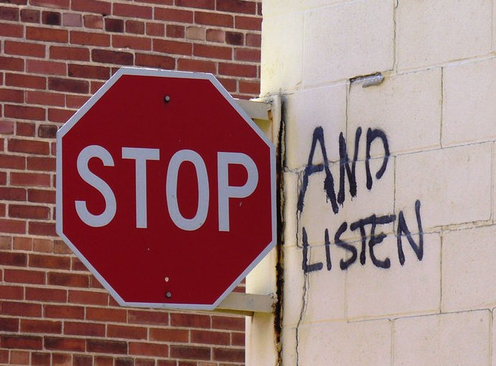
‘Be an active listener.’
Notes:
What makes a good listener? What have we learned?
Collate answers on the board, but these should include things such as:
No interrupting
Not immediately trying to solve issues
Listening to understand and not listening to respond
Body language (eye contact, nodding, vocalisations etc)
The important point here is that life is busy, but we need to stop and listen actively. – It helps us to slow down and helps our friends. This aids our and their resilience levels.

Slide 14
Any questions?
Notes:
Are there any questions that have arisen today as a result of this session? Anything you’d like to know more about or discuss in more detail?

