Slide 1
The Multi-Schools Council Resilience Programme

Slide 2
Session 5
What is self-esteem?
Self-esteem activity
The social media world
Questions
Notes:
Over the past four sessions we’ve looked at worries, stresses, the impact our mood can have, ways to regulate ourselves when we are overwhelmed and given ourselves a number of strategies to help us. We’ve created the wellbeing plate and looked at the ladder up and down our own version of Maslow’s pyramid.
Today we’re going to look at self-esteem (which you’ll remember is part of Maslow’s pyramid) and the things that can impact that – including social media.
At the end, there’ll be opportunities for questions.

Slide 3
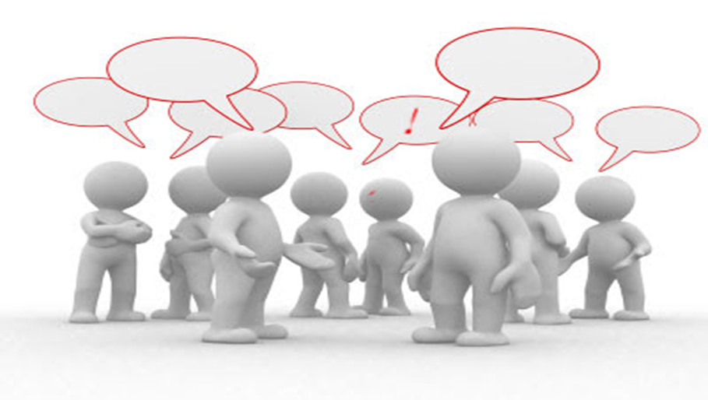
What is self-esteem?
Speak to the person next to you, what do you think?
Notes:
Speak to the person next to you – what is self-esteem to you? Your friends etc?
Take some feedback from round the room and try to come up with a group definition which can be written on the board.

Slide 4
Activity 1
In your small groups one person will leave the room
While that person is out of the room the group must write down their name on the sugar paper in the middle and mind map all the good things about that person
The person who was out the room will then come in and try to guess who said what
The activity will take a while but stick with it!
Notes:
Now we’ll have a go at the main activity of this session. Firstly, get yourselves into small groups of 4-5 people.
In a minutes I’m going to ask one person to leave your group and stand outside the door (or other safe area where they can’t see/hear the activity).
The rest of the group, write that person’s name in middle of your sheet of paper, and everyone in the group has to write positive things about that person. This can be things like: friendly, good at football, kind, artistic etc. Write as many things as you can.
Then we’ll invite the person back into your group and they will choose try to guess who has made the comment about them, and that person can explain why they chose that word/phrase. The person will get to keep the sheet of paper about them.
We’ll keep doing this activity until everyone has had a turn. I appreciate that some people will find this uncomfortable as we’re not always very good about accepting praise, but we will be keeping these sheets in order to build our resilience and remind ourselves, in the bad times, of all the things people admire about us.
Over time, as our self-esteem increases, it builds our resilience.
Repeat activity until every CYP has had a turn. These sheets can be kept with their wellbeing plates and pyramids.

Slide 5
What are these logos of?
Notes:
What are these logos of?
Pupils respond. Ask if there are any more they use that are not on here (ie tiktok).
Split pupils into groups or pairs (dependent on numbers).
In your group/pair I want you to consider the app you’ve been given. You need to create a list of they ways in which the app can IMPROVE your self-esteem and a list of the ways the app can DAMAGE your self-esteem. You may also want to consider the dangers of the app in terms of your personal security/safeguarding.
Allow five minutes for this activity and ask groups to feedback to the rest of the class. Draw out the positives and negatives of social media in relation to self-esteem and resilience.

Slide 6
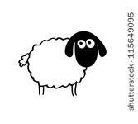
How does this image fit in?
Notes:
How does this image link to the conversation we’re having today about self-esteem, and also the influence of social media?
Take feedback from the group. Draw out the following:
Just because that you follow people in life as humans, we shouldn’t feel under pressure to follow anyone on social media.
People ‘liking’ your photo isn’t people ‘liking’ you in real life, and the opposite.
Don’t allow the number of likes or followers to influence your self-esteem.
Anything you post can be viewed in a different way to how we want it to be seen.
Things posted online can stay there forever (link to job-seeking in the future and the impact of previous comments/posts.
Everything may not be what it seems – people tend to only post the good things
Remember, if there are any concerns, issues, worries or any bullying, you can always seek help here in school or through online support groups.

Slide 7
Quote:
Notes:
What do you think of this quote? What is he trying to say?
Take feedback from CYP and relate it to the last ‘sheep’ slide.

Slide 8
Activity 2
If you were in charge of the ‘social media world’ what would you change?
Notes:
For the final part of this session, discuss in your pair or groups the following: if YOU were in charge of social media, what would you do differently in order to protect people?
Draw out answers such as screentime, age limits, need for more regulation, a way to battle the trolls and anything else they come up with.

Slide 9
Any questions?
Notes:
Are there any questions that have arisen today as a result of this session? Anything you’d like to know more about or discuss in more detail?

