Slide 2
Pilot objective and opportunities
“Ensure schools are protected in an unregulated part of the market and able to access best in class commercial deals”
Risk reduction
Simplification
Savings

Slide 3
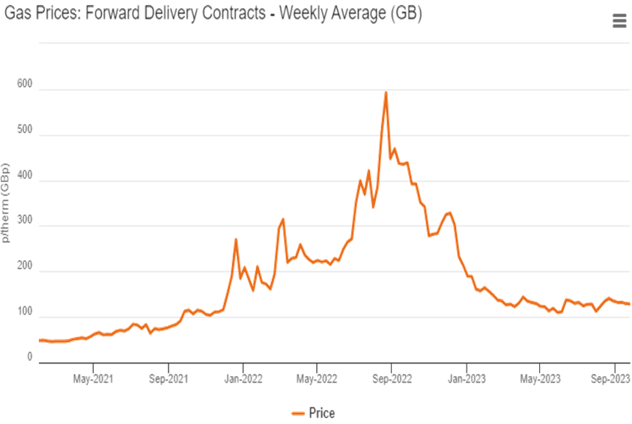
Reducing risk of schools’ exposure to market volatility
Prices have gone up, schools are struggling. The long term outlook is for prices to remain high and the market to continue to be more susceptible to volatility.
There is risk in how many schools currently contract; fixed term, fixed price contracts negatively affected a significant number of schools, we can help reduce this risk.

Slide 4
Summary of engagement
Average price p/kwh
Power
Gas
100%
Circa 2K
3rd party intermediaries
>36%
Schools represented
School average
DfE “Deal”
All MATs used/are using a 3rd party to manage their energy contracts/procurement across varying levels of support
School average
DfE “Deal”
>45%
Schools represented across 50+ MATs
Engagement with CEO’s, CFO’s, procurement teams, estates, energy managers
Fix
Flex
%age saving is based on historic charges; i.e. what schools actually paid vs what they would have paid in the V30 basket.
Half of contracts are fixed price, half are flexibly bought

Slide 6
Common Q’s
What is an Interim rate? An Interim rate is essentially just a bridging contract until you transition onto the next available V30 basket (depending on when your current contract expires). You don’t have to worry about the contracting side of things as we move you into the V30 basket automatically once your interim contract expires. They bring the broader framework benefits around procurement assurance, alignment with public sector policy (social value, data security etc.). We can provide the current interim rates, however, please note that these fluctuate and are subject to market conditions and are not a guarantee of the rates you will be paying.
What if my current contract is already with CCS? You are able to novate your current contract onto the V30 basket under the DfE contract.
Do I need to terminate my existing contracts? You will need to refer to the contractual obligations in your current contract to determine the termination clauses and notice period. The DfE can provide a copy of a Notice of Termination Template for you to populate. The DfE cannot support the termination of your existing contracts. If you receive your energy through your LA you must ensure you seek approval from them to move to another source of energy supply
Can I add additional sites during the course of the contract? Yes, you will just need to provide site information, and they can be added to the DfE account like any other School in your Trust.
How does DfE buy its energy? DfE like other Central Government departments are mandated by HM Treasury to take advantage of CCS’ energy frameworks for gas and electricity. All central government departments use the CCS V30 basket to compliantly procure their energy supply.
How does the V30 compare to a fixed rate basket? The V30 basket has outperformed the locked baskets over the last few years due to the volatile energy market. With V30 as it trades over the longer period the fluctuations are not as significant as other baskets, reducing the volatility, however this may mean V30 is not always the cheapest.
How long I am committed for? The contract will last for 3 years. You must commit so the V30 basket for 3 years. To leave you will need to give 30 months’ notice prior to the renewal date. You can only terminate within 1 month, if the building is sold, demolished or change of tenancy. The contract is evergreen and will renew each year unless termination notice is given.

Slide 7
Checklist
Letter of Authority – signed by both parties to allow DfE to act on behalf of your school/trust.
Site Addition Templates (gas and electricity)
Novation Templates (if CCS customer)
Complete billing preferences and annual consumption data
VAT Certificate
CCL Certificate
DD Mandate (if applicable)
Portal access (gas and electricity)
Objections – your current supplier may object to the transfer if you have either not given notice, or you have outstanding debt.

Slide 8
Working model – energy as a service
DfE become the “contracting authority” and the main point of contact for schools
DfE manage onboarding of schools to “DfE energy” deal; transitioning schools to longer term, flexibly traded baskets
Schools continue to pay bills directly
Consistent data set compiled for schools - creates consistent sector data set covering e.g. consumption and net zero reporting from half-hourly data.
Centralised support means direct access to DESNZ/supply chain to improve smart meter roll out and targeted support on to retrofit/funding bids
For more information contact: dfe-energy.services-team@education.gov.uk

Slide 9
Cost Recovery Contract
Forensic Audit of your settled energy billing
Period covered: previous 6 years (5 years in Scotland)
An interrogation of the Wholesale costs and Non-commodity ‘pass through’ charges

Slide 10
How to access the Cost Recovery Contract
This service is quick and easy to access. You simply need to:
Complete an expression of interest form - Energy cost recovery services for schools
You will then be contacted by the DfE to complete a Letter of Engagement
Once this has been signed by both parties you will need to complete a Letter of Authority enabling PCMG to deal directly on your behalf with your suppliers to obtain the necessary information
As part of the engagement with this contract, the school and trust are agreeing that all collated utility spend data will be shared with the DfE which will be used to inform further energy work by the DfE

